Slide 1
Relative Motion Analysis using Scalar Notation
Dr. Jacob Moore
Associate Professor of Engineering
Penn State Mont Alto

Slide 2
Planar Motion Analysis
When analyzing rigid body motion beyond fixed axis rotation. There are two general strategies, absolute motion analysis, and relative motion analysis.
In absolute motion analysis, a set of constraint equations is used to determine the position of a set point over time with respect to the ground, the velocity and acceleration of that point will be equal to the derivatives of the original equation.
In relative motion analysis, a series of equations describe the positions, velocities, and accelerations of several intermediate points leading from the ground to the point of interest. General polar motion equations are used to describe velocities and accelerations for each step, and the steps are all added together in the end.

Slide 3
Absolute vs. Relative Analysis
Absolute Motion Analysis:
Involves calculus
Does not involve coordinate transformations
Faster and easier for simple problems
Relative Motion Analysis:
Does not involve calculus
Involves coordinate transformations
Faster and easier for complex problems

Slide 4
Relative Motion Analysis
In relative motion analysis we identify the velocities and accelerations by breaking down motion into steps and adding those motions together
What separates relative motion analysis from absolute motion analysis is that we use pre-determined equations for velocity and acceleration, rather than taking derivatives
These equations are based on a polar coordinate system.
We will wind up with the same equations we had in absolute motion analysis, but we will not be taking derivatives to find these equations.

Slide 5
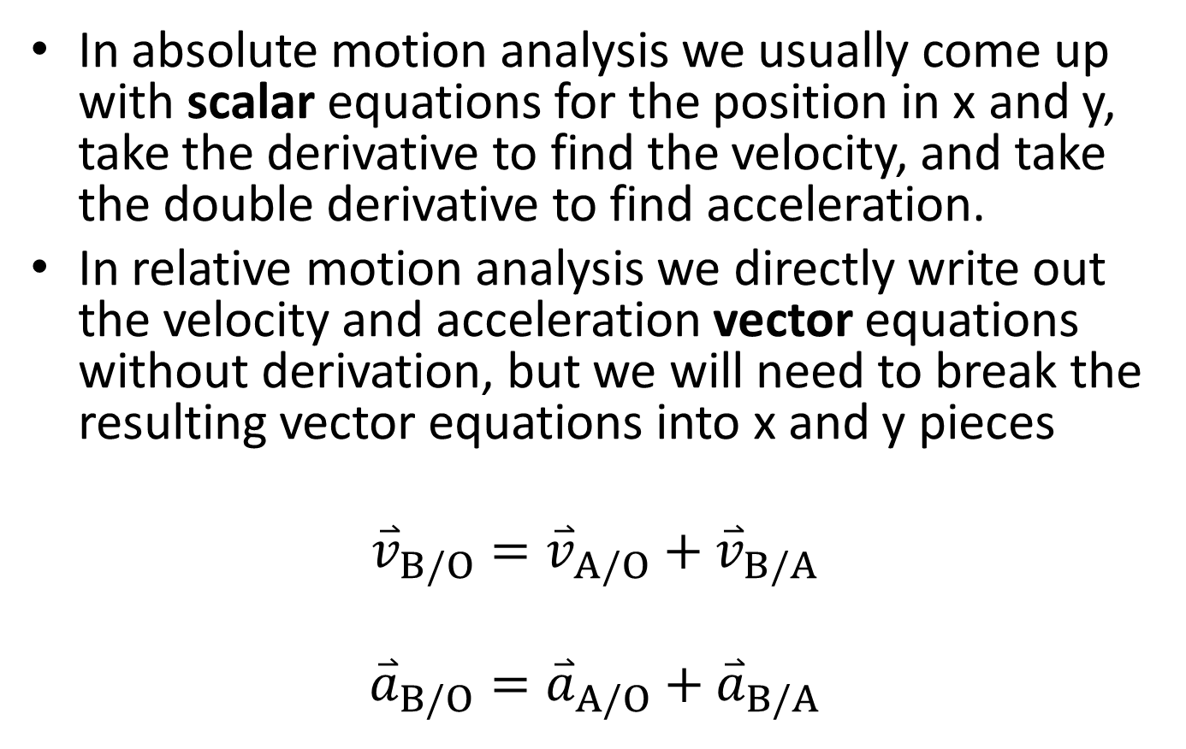
Relative Motion Analysis
In absolute motion analysis we usually come up with scalar equations for the position in x and y, take the derivative to find the velocity, and take the double derivative to find acceleration.
In relative motion analysis we directly write out the velocity and acceleration vector equations without derivation, but we will need to break the resulting vector equations into x and y pieces
$${\overset{⃑}{v}}_{B/O}={\overset{⃑}{v}}_{A/O}+{\overset{⃑}{v}}_{B/A}$$
$${\overset{⃑}{a}}_{B/O}={\overset{⃑}{a}}_{A/O}+{\overset{⃑}{a}}_{B/A}$$

Slide 6
Multiple Coordinate Systems
In relative motion analysis, each piece of the body will have its own coordinate system
Each piece’s velocities and accelerations will be in its own coordinate system
$${\hat{u}}_{θ2}$$
$${\hat{u}}_{θ1}$$
$${\hat{u}}_{r2}$$
C
$$ϕ$$
$${\hat{u}}_{r1}$$
$$θ$$
B
y
$$θ$$
x
A

Slide 7
Relative Motion Analysis (Velocity)
As stated earlier, the goal in relative motion analysis is usually to break the complex motion of a point down into a series of simple rotations and/or simple translations.
Starting with velocity of a point in polar coordinates
$$v\left(t\right)=\dot{r} {\hat{u}}_{r}+r\dot{θ}{\hat{u}}_{θ}$$
If we just have rotation, we are left with…
$$v\left(t\right)=r\dot{θ}{\hat{u}}_{θ}$$
If we just have extension along a fixed axis we have…
$$v\left(t\right)=\dot{r} {\hat{u}}_{r}$$

Slide 8
Relative Motion Analysis (Acceleration)
If we look at the acceleration of a point in polar coordinates we have the equation...
$$a\left(t\right)= \left(\ddot{r}−r{\dot{θ}}^{2}\right) {\hat{u}}_{r}+\left(r\ddot{θ}+2\dot{r}\dot{θ}\right) {\hat{u}}_{θ}$$
If we assume that we have a rigid body rotating about an axis, we can eliminate the variables that relate to the changes in r and we are left with...
$$a\left(t\right)= \left(−r{\dot{θ}}^{2}\right) {\hat{u}}_{r}+\left(r\ddot{θ}\right) {\hat{u}}_{θ}$$
If we have a simple extension along a fixed axis we are left with...
$$a\left(t\right)= \left(\ddot{r}\right) {\hat{u}}_{r}$$

Slide 9
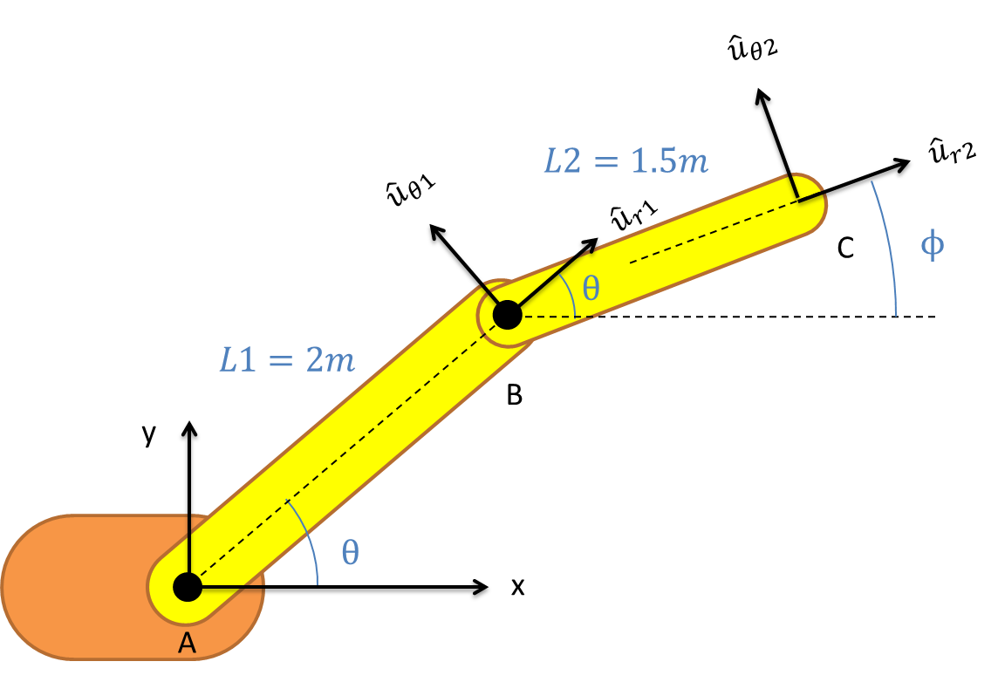
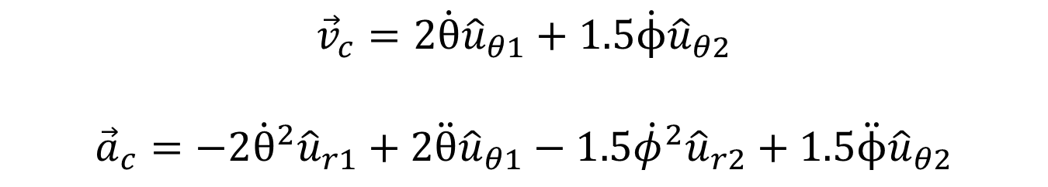
Relative Motion Analysis
$${\vec{v}}_{c}=2\dot{θ}{\hat{u}}_{θ1}+1.5\dot{ϕ}{\hat{u}}_{θ2}$$
$${\vec{a}}_{c}=−2{\dot{θ}}^{2}{\hat{u}}_{r1}+2\ddot{θ}{\hat{u}}_{θ1}−1.5{\dot{φ}}^{2}{\hat{u}}_{r2}+1.5\ddot{ϕ}{\hat{u}}_{θ2}$$

Slide 10
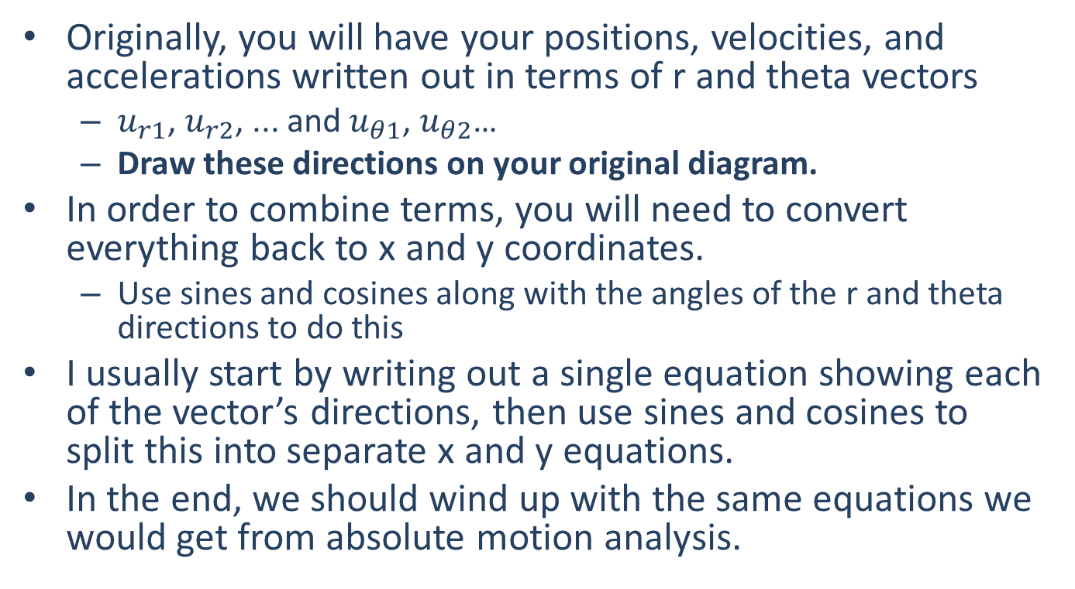
Dealing with Multiple Coordinate Systems
Originally, you will have your positions, velocities, and accelerations written out in terms of r and theta vectors
$u_{r1}$, $u_{r2}$, ... and $u_{θ1}$, $u_{θ2}$…
Draw these directions on your original diagram.
In order to combine terms, you will need to convert everything back to x and y coordinates.
Use sines and cosines along with the angles of the r and theta directions to do this
I usually start by writing out a single equation showing each of the vector’s directions, then use sines and cosines to split this into separate x and y equations.
In the end, we should wind up with the same equations we would get from absolute motion analysis.

Slide 11
Relative Motion Analysis Process
Start by creating a diagram of the body, with the key distances and angles labeled
Be sure to label your r and theta directions
Also identify what distances and/or angles remain constant and what distances or angles change over time
Next, pick a point for analysis and use the pre-determined velocity and acceleration vector equation
Draw in the r and theta direction angles if that helps you break them down later
Use sines and cosines to break down your vector equations into x and y scalar equations
Use the equations you have generated, along with any current angles, distances, velocities, and accelerations to solve for the unknowns

Slide 12
Thanks for Watching
See other engineering mechanics videos and access the full tool at…

Slide 13
Worked Example
The robotic arm shown below has a fixed orange base at A and fixed length members AB and BC. Motors at A and B allow for rotational motion at the joints. Based on the angular velocities and accelerations shown at each joint, determine the velocity and the acceleration of the end effector at C.
y
A
3 ft
B
x
30º
5 rad/s
3 rad/s
-2 rad/s²
.2 rad/s²
2 ft
C

Slide 14


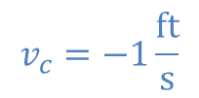
Worked Example
The robotic arm from the previous problem is in the configuration shown below. Assume that theta is currently 30 degrees and that point C currently lies along the x axis. If we want the end effector at C to travel 1 ft/s in the negative x direction, what should the angular velocities be at joints A and B?
y
B
3 ft
2 ft
$$ϕ$$
$$θ$$
x
$$v_{c}=−1\frac{ft}{s}$$
A
C

Slide 15
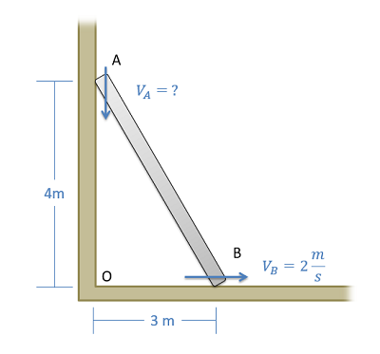
Worked Example
A ladder is propped up against a wall as shown below. If the base of the ladder is sliding out at a speed of 2 m/s, what is the speed of the top of the ladder?

Slide 16
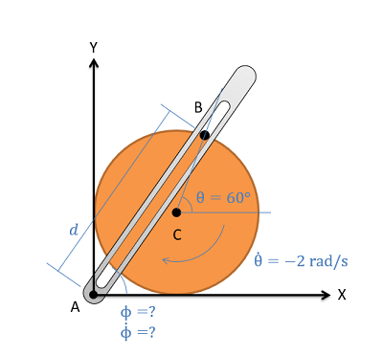
Worked Example
The crank-rocker mechanism as shown below consists of a crank with a radius of .5 meters rotating about its fixed center at C at a constant rate of 2 rad/s clockwise. Rocker AB fixed at it's base at A and connects to point B along the edge of the crank. The pin at point B can slide along a frictionless slot in AB. In the current state, what is the angular velocity of rocker AB?

